Slide 1
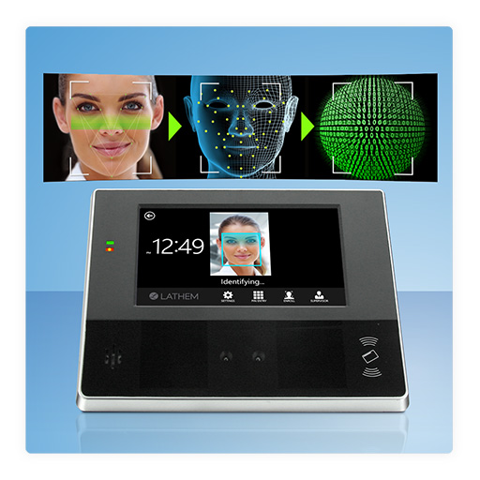
Real-Time Face Recognition Check In-Out Program

Slide 2
Introduction
The Real-Time Face Recognition Check-In/Check-Out Program for Organizations is a capstone project that aims to develop a program that can replace traditional punch clock systems used in organizations.
The proposed program leverages a facial recognition technology to eliminate long lines and increase efficiency in attendance registration.

Slide 3
Problem Statement
Current attendance registration systems used in organizations rely on traditional punch clock systems that use physical cards or badges to register employee attendance.
These systems are not without their drawbacks, as they can be easily manipulated, leading to inaccurate records, potential time theft, and unnecessary delays due to long lines and bottlenecks during peak hours.
The proposed program aims to eliminate these problems by developing a more reliable and efficient attendance registration system.

Slide 4
Objectives
The Real-Time Face Recognition Check-In/Check-Out Program for Organizations aims to achieve the following objectives:
Accurate processing of payroll based on an employee's work hours.
Identification of inconsistent attendance to address issues and ensure productivity.
Creation of a viable schedule based on realistic data for better management.
Simplification of payroll processes for employees.

Slide 5
Implementation
The Real-Time Face Recognition Check-In/Check-Out Program for Organizations is linked to a real-time database that allows for seamless storage and retrieval of employee information, including images and relevant data.

Slide 6
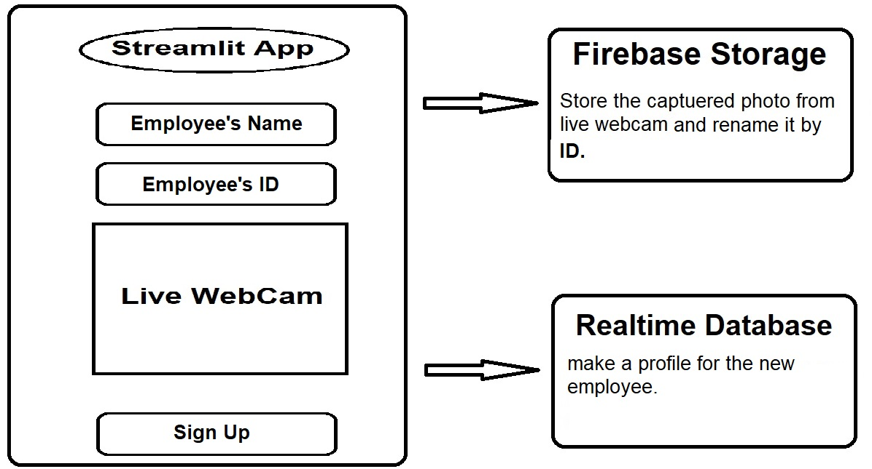
Implementation: Sign up

Slide 7
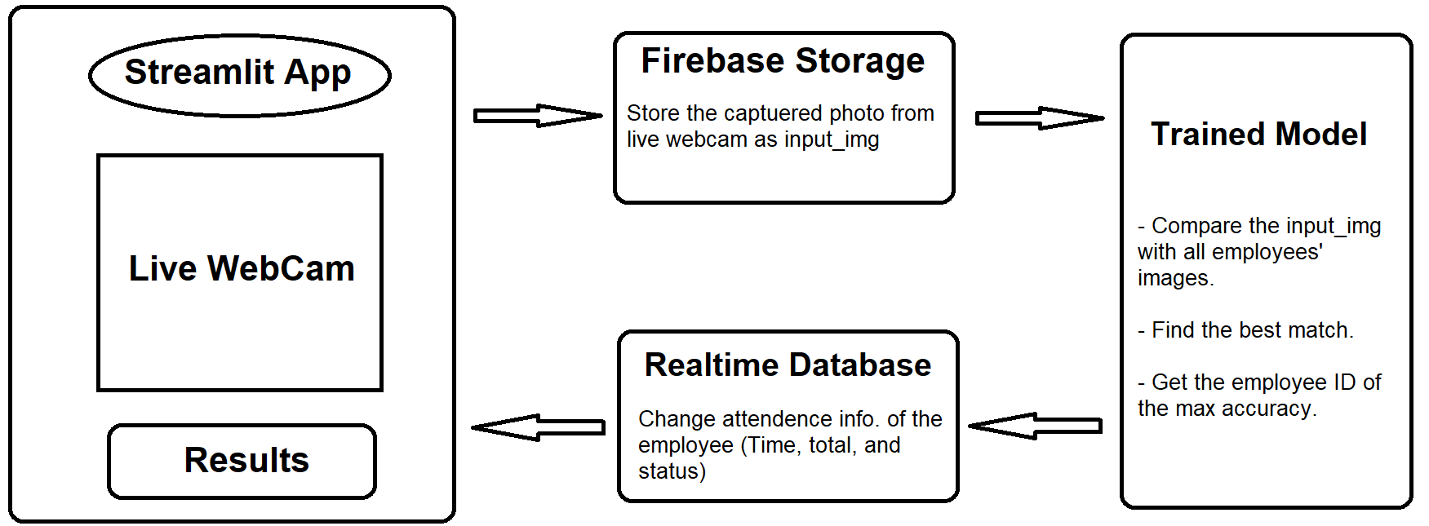
Implementation: Check in out

Slide 8
Implementation
Connecting the program to a live camera.
Coding the face recognition model and training it using the Keras library.
Developing the encoding generator.
Building the data app UI using Streamlit.
Creating a real-time database using Firebase.
Deploying the app on Streamlit Share.

Slide 9
Datasets
The model is trained using three datasets

Slide 10
Labeled Faces in the Wild Home (LFW) dataset
It is a popular benchmark dataset in computer vision.
The dataset contains over 13,000 images of faces collected from the internet and is widely used for tasks such as face recognition and verification.
The LFW dataset is notable for its large size, diversity of subjects, and real-world conditions, such as variability in pose, lighting, and facial expressions.
The dataset is freely available for download and has been used in numerous research papers and competitions in computer vision.
http://vis-www.cs.umass.edu/lfw/

Slide 11
DrivFace dataset
It is a collection of images designed for use in computer vision and machine learning applications.
It was collected using a camera mounted inside a car and includes images of drivers with varying head poses and lighting conditions. The dataset contains approximately 606 images of 4 individuals, with each individual's face captured under a range of different driving conditions.
It has been widely used in research on facial recognition, head pose estimation, and other computer vision tasks, and is available for download from the UCI Machine Learning Repository https://archive.ics.uci.edu/ml/datasets/DrivFace.

Slide 12
Generated Dataset
A dataset created by the developer using CV2 and the laptop camera.
This allows to capture images of myself under various lighting conditions and facial expressions and add them to the dataset for increased diversity.

Slide 13
Image augmentation
Image augmentation can be useful for generating a larger and more diverse dataset for training deep learning models.
The data augmentation process involves applying a set of random transformations to the input image. Specifically, the function applies:
A stateless random brightness adjustment.
A stateless random contrast adjustment.
A stateless random flip left-right.
A stateless random JPEG quality adjustment.
A stateless random saturation adjustment.

Slide 14




Image augmentation

Slide 15
Model training
The paper "Siamese Neural Networks for One-shot Image Recognition" by Koch et al. provided the inspiration for building a model for one-shot image recognition.
The paper proposes a method for learning a similarity metric between two images using a Siamese neural network architecture.
The Siamese network consists of two identical sub-networks that share the same set of weights, and the input images are passed through these sub-networks to produce feature vectors. The distance between the feature vectors of two images is then used as a measure of similarity between those images.

Slide 16
Model training

Slide 17
Model training
This approach allows the model to learn to recognize objects even with very few training examples. The paper's experimental results showed that their method outperformed previous methods for one-shot image recognition, demonstrating the potential of Siamese networks in this domain.
By adapting the Siamese network architecture and training process described in this paper to my specific use case, I was able to build a model that achieved impressive accuracy in recognizing similar faces in images with only a few examples.

Slide 18
Streamlit
Streamlit is an open-source Python library used for creating data-driven web applications.
It allows developers to build interactive and customizable web apps using familiar Python syntax, without having to worry about the underlying web technologies such as HTML, CSS, and JavaScript.
Streamlit also includes built-in support for live reloading, which means that your application will automatically update whenever you make changes to the underlying code. This makes it easy to experiment with different data visualizations or UI layouts without having to restart the application.
Overall, Streamlit is a powerful tool for building data-driven web applications with minimal setup and configuration.

Slide 19
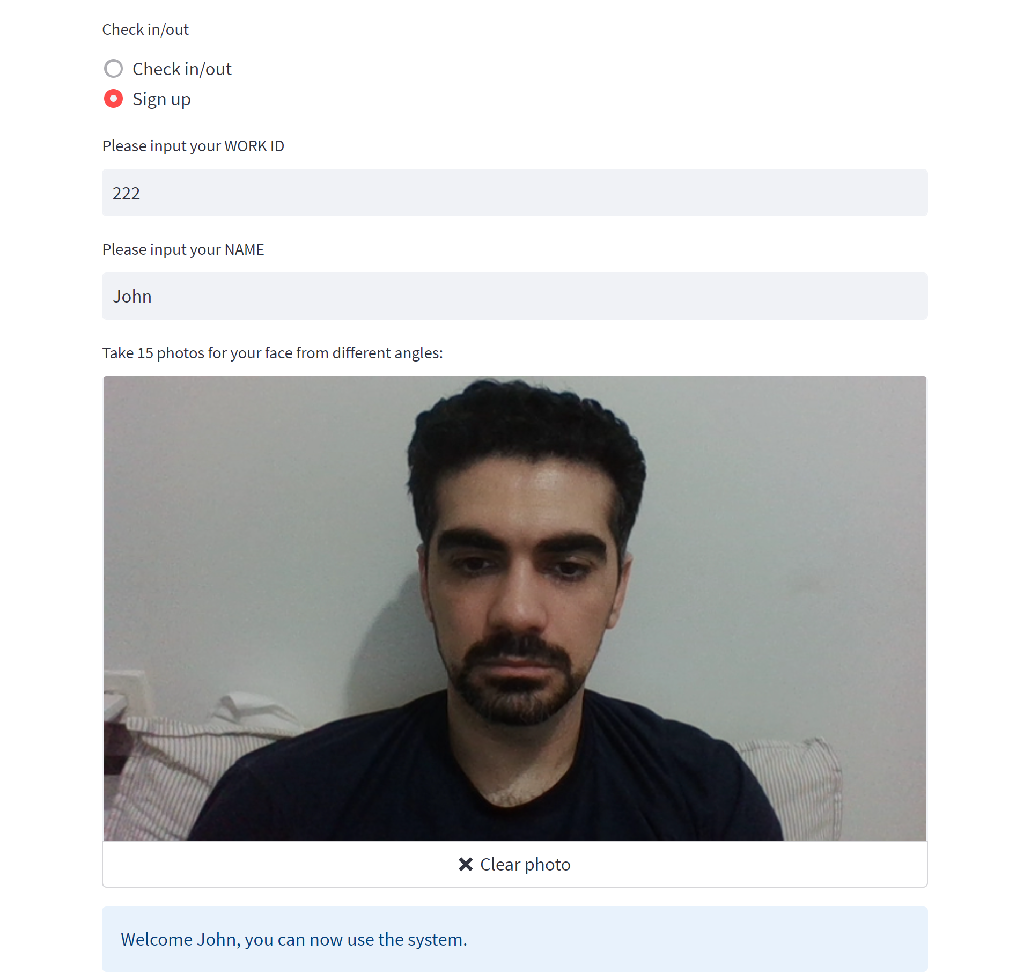
Streamlit: Sign up webpage

Slide 20
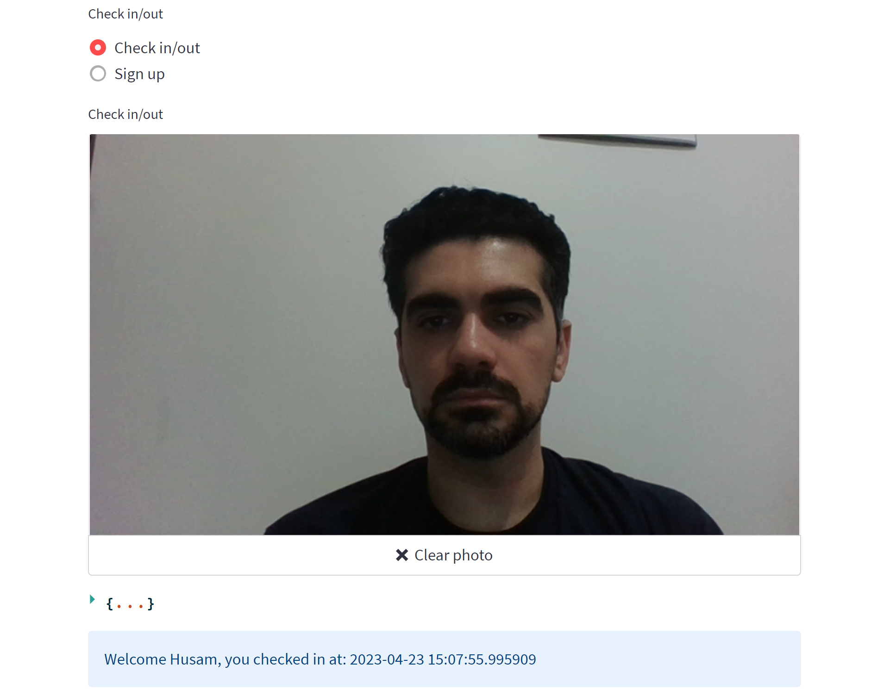
Streamlit: check in webpage

Slide 21
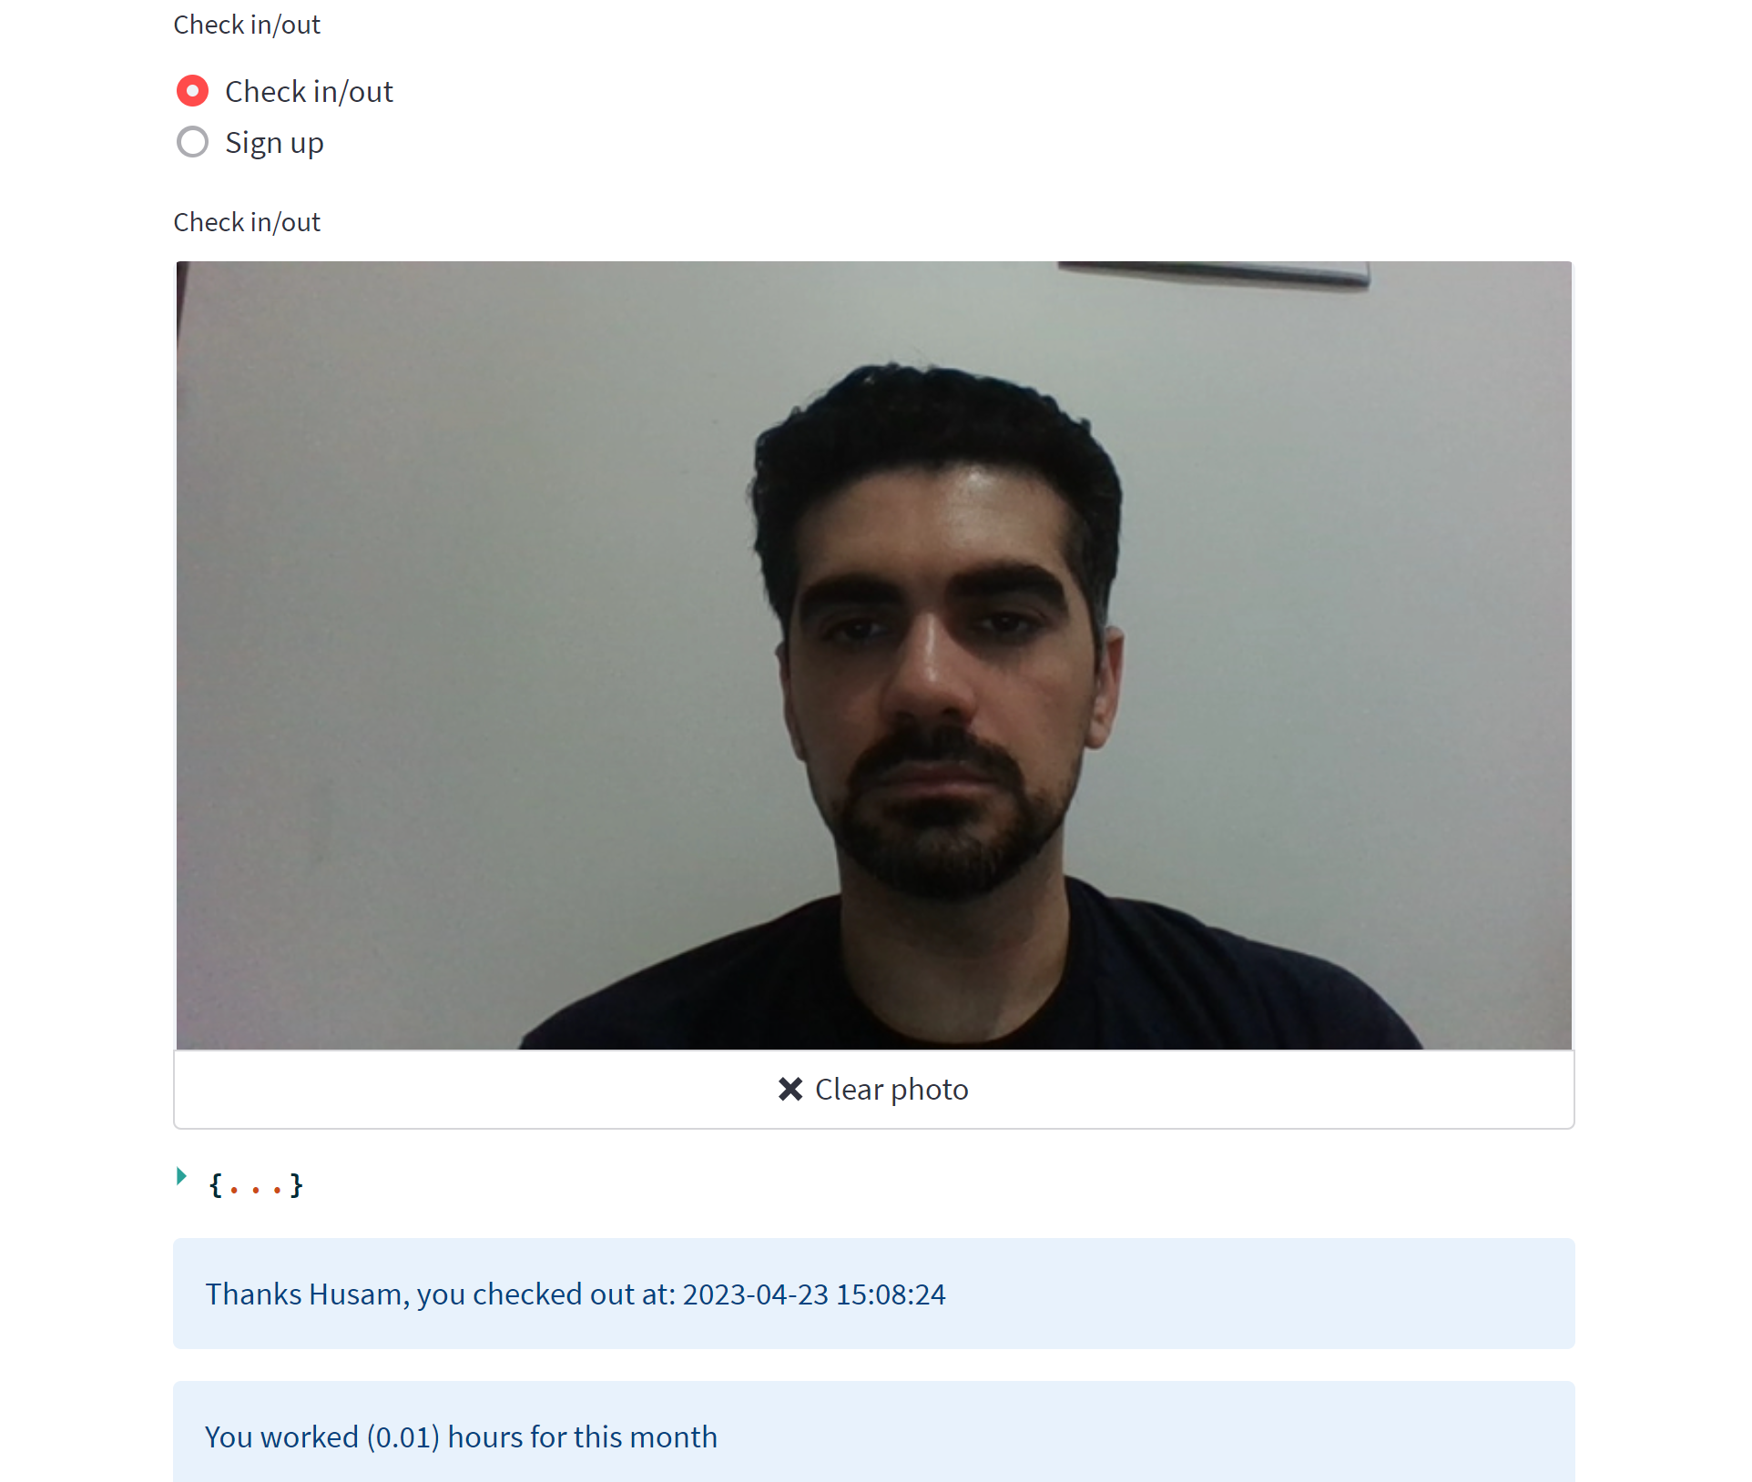
Streamlit: check out webpage

Slide 22
Streamlit share
Streamlit Share is a cloud-based platform provided by Streamlit that allows developers to deploy, share, and collaborate on their Streamlit applications.
It is a free service that allows hosting and sharing Streamlit applications with anyone, without having to worry about managing servers or infrastructure.
Can set up automated deployments and continuous integration with GitHub, making it easy to update and deploy your applications with each new code change.

Slide 23
Firebase
Firebase is a mobile and web application development platform that provides a suite of tools and services to help developers build high-quality, scalable, and secure applications.
It is a cloud-based platform that offers a range of features including authentication, real-time database, storage, hosting, and more.
One of the most popular platforms for building modern web and mobile applications.
Its main goal is to provide a complete backend infrastructure for developers, so that they can focus on building great user experiences without worrying about the underlying infrastructure.

Slide 24
real-time database
Firebase Realtime Database is a NoSQL cloud-hosted database that stores data in JSON format and allows developers to synchronize data between clients and servers in real-time.
It is designed to support real-time applications that require rapid and frequent updates to data.
The Firebase Realtime Database uses a client-server synchronization model, where any updates made by one client are immediately propagated to all other connected clients, providing a seamless and real-time user experience.

Slide 25
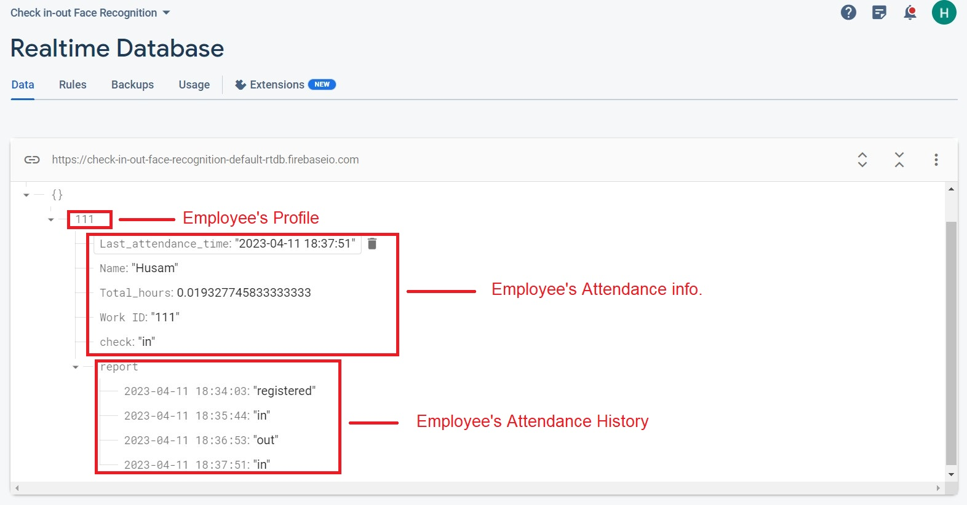
real-time database

Slide 26
storage
Firebase Storage is a powerful and flexible cloud-based storage solution, which allows developers to store and serve user-generated content such as images, videos, and other media files.
It provides a simple, secure, and scalable way to store and serve files from the cloud, with features like uploading and downloading, automatic scalability and redundant backups.

Slide 27
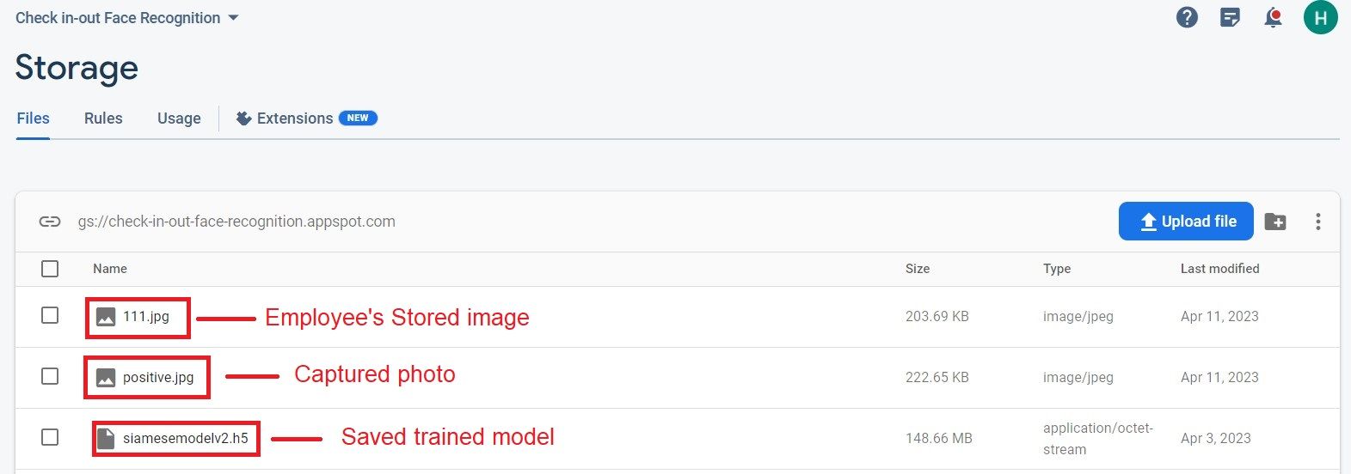
storage

Slide 28
challenges faced during project implementation

Slide 29
CNN model architecture
One of the challenges faced during the project was identifying the optimal CNN model architecture.
After conducting research, the Siamese Neural Networks for One-shot Image Recognition article was discovered, which presented a promising CNN model architecture.
The decision was made to utilize this architecture for the project.
Paper: https://www.cs.cmu.edu/~rsalakhu/papers/oneshot1.pdf

Slide 30
CNN model architecture

Slide 31
Datasets
One challenge encountered during the project was low model accuracy due to the dataset used.
The initial dataset consisted of negative images from LFW and positive images from my photos, which resulted in low accuracy.
To address this, the driveface dataset was added to increase diversity in the positive images, but the improvement was not significant.
Finally, a new dataset was created by augmenting images from three different sources, resulting in an accuracy between 95% and 97%.

Slide 32
The app user interface
One of the challenges encountered during the project was a lack of experience with front-end development using HTML, CSS, and JS.
As a result, alternative solutions were explored to create a user interface for the app to utilize the trained model.
After conducting research, an open-source Python library was discovered that could assist developers in building an app UI without requiring knowledge of HTML, CSS, or JS.

Slide 33
Database and storage
One of the challenges encountered during the project was identifying a suitable method for storing both the captured images and the trained model.
Additionally, a way to create a real-time database to save information about employees and retrieve it was needed.
After conducting research, Firebase was found to be a solution that could assist developers in building a real-time database and storage to save images and the model.

Slide 34
the trained model size
One of the challenges encountered during the project was the large size of the trained model, which was approximately 150MB.
Despite the limitation of Google Colab's free subscription, efforts were made to decrease the model size by converting it to tflite format.
Although the conversion process could not be completed due to RAM limitations, the project was designed to be compatible with the tflite version of the model once it becomes available.

Slide 35
Streamlit webcam frame size
One of the primary challenges that developres may face when working with webcam input in Streamlit is the inability to control the size of the webcam frame accurately, which can affect the accuracy of face detection and recognition algorithms.
Accurately cropping the face from the input image is critical for ensuring that the model can correctly identify and recognize the face.
If the size of the webcam frame cannot be controlled accurately, it can lead to differences in the cropping of the face, causing discrepancies in the model results.

Slide 36
Questions?

